Slide 1
III Crystal Symmetry
3-1 Symmetry elements
(1) Translation:
Example: 1D lattice:
2D lattice:
3D lattice:
Crystal = “motif” repeated at each lattice point
Atom, molecule

Slide 2
(2) Rotation symmetry
one fold 1
two fold (diad ) 2
three fold (triad ) 3
Four fold (tetrad ) 4
Six fold (hexad ) 6

Slide 3
Proof: There are only 1, 2, 3, 4, and 6 fold
rotation symmetries for crystal with
translational symmetry.
graphically
The space cannot
be filled!

Slide 4
Axis A, angle α
n: integer
n fold axis
Notation n
Example:
4
A
Only certain types of rotations are consistent with lattice
Periodicity (kepler):
p: integer:

Slide 5
p | cosα | α | n
3 | -1 | 180º | 2
2 | -1/2 | 120º | 3
1 | 0 | 90º | 4
0 | 1/2 | 60º | 6
-1 | 1 | 0º | 1
Crystallographic
rotation axes

Slide 6
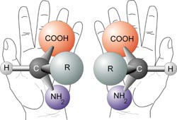
(3) Reflection (mirror) symmetry m
Examples:
LH
RH
H
H
C = C
Cl
Cl
m
mirror
(4) Inversion symmetry (center of symmetry) $\overline{1}$
RH
Example:
H
Cl
C = C
LH
i
Cl
H

Slide 7
Enantiomorphism
Enantiomorphic bodies have a “handedness” (chirality)
e.g. your left and right hand
They can not be made to coincide by translation or rotation,
only by reflection (your hand) or inversion
Example
H
H
C
C
F
F
X
Cl
Cl
X
Note: a body with reflection or inversion symmetry can not
be chiral.

Slide 8
(5) Rotation-Inversion axis
Combinations of
Symmetry Elements
$$\frac{{360}^{o}}{n}$$
= Rotate by
，then invert.
(a) one fold rotation inversion ($\overline{1})$
top view
Side view
i
A
(b) two fold rotation inversion ($\overline{2})$
= mirror symmetry (m)
A
m
i

Slide 9
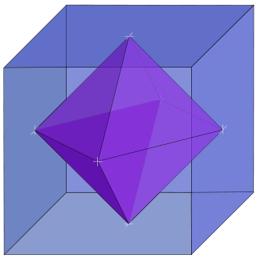
(c) inversion triad ($\overline{3}$)
3
= Octahedral site in
an octahedron

Slide 10
(d) inversion tetrad ($\overline{4}$)
x
= tetrahedral site in a
tetrahedron
(e) inversion hexad ($\overline{6}$)
x
Hexagonal close-packed (hcp) lattice

Slide 11
(6) Screw axis: rotation about A, then translation by
τ // A
A
A
t: lattice translation
vector along A
3₁
3₂
In a lattice: translation vector along A is t
requirement:
}
pitch
for the "crystallographic"
screw axes

Slide 12
2
2₁
3
3₁
3₂
4
4₁
4₂
4₃

Slide 13
6
6₁
6₂
6₃
6₄
6₅

Slide 14
Example of 6₃ screw axis: hcp
A
B
Basal
plane
6₃

Slide 15
(7) Glide plane: translation by τ (in m), reflect about m
In lattice: t = translation distance along glide direction
Example: diamond cubic
Glide plane
Glide direction

Slide 16
Screw axis and glide plane involve translation: symmetry elements for space group not for point group!
Symmorphic space group is defined as a space group that may be specified entirely by symmetry operation acting at a common point (the operations need not involve τ) as well as the unit cell translation. (73 space groups)
Nonsymmorphic space group is defined as a space group involving at least a translation τ.

Slide 17
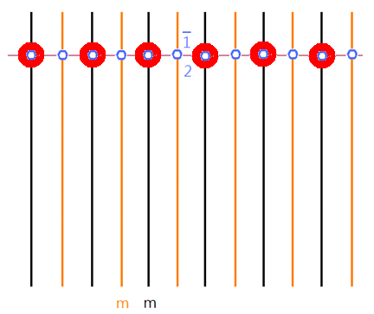
3-2. Fourteen Bravais lattice structures
3-2-1. 1-D lattice
3 types of symmetry can be arranged in a 1-D lattice
mirror symmetry (m)
= 2-fold rotation (2)
= center of symmetry ($\overline{1 }$)

Slide 18
3-2-2. 2-D lattice
Two ways to repeat 1-D ⇒ 2D
(1) maintain 1-D symmetry
(2) destroy 1-D symmetry
m 2 $\overline{1}$

Slide 19
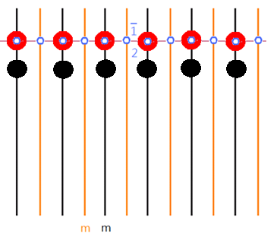
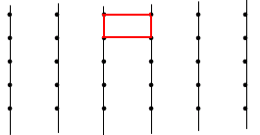
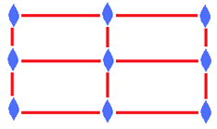
(a) Rectangular lattice ($a≠b$; $γ=$ 90º)
Maintain mirror symmetry m
($a≠b$; $γ=$ 90º)

Slide 20
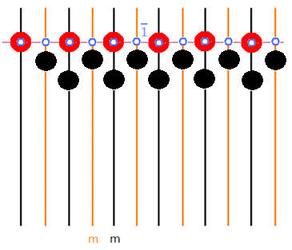
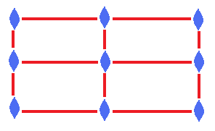
(b) Center Rectangular lattice ($a≠b$; $γ=$ 90º)
Maintain mirror symmetry m
($a≠b$; $γ=$ 90º)
Rhombus cell
(Primitive unit cell)
$a=b$; $γ≠$ 90º

Slide 21
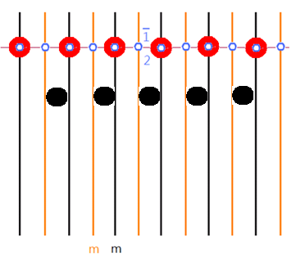
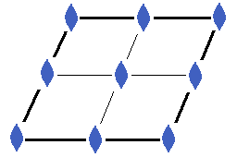
(c) Parallelogram lattice ($a≠b$; $γ≠$ 90º)
Destroy mirror symmetry

Slide 22
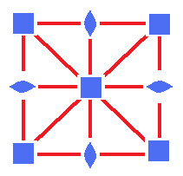
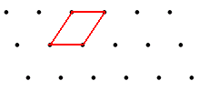
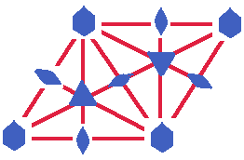
(d) Square lattice ($a=b$; $γ=$ 90º)
b
a
(e) hexagonal lattice ($a=b$; $γ=$ 120º)

Slide 23
Symmetry elements in 2D lattice
Rectangular = center rectangular?

Slide 24
3-2-3. 3-D lattice: 7 systems, 14 Bravais lattices
Starting from parallelogram lattice
($a≠b$; $γ≠$ 90º)
(1)Triclinic system 1-fold rotation (1)
c
α
β
γ
b
a
($a≠b≠c$; $α≠β≠γ≠$ 90º)

Slide 25
lattice center symmetry at lattice point as shown above which the molecule is isotropic ($\overline{1}$)

Slide 26
(2) Monoclinic system
($a≠b≠c$; $α=β=\text{90}\text{o}≠γ$)
one diad axis
(only one axis perpendicular to the drawing plane maintain 2-fold symmetry in a parallelogram lattice)

Slide 27
(1) Primitive monoclinic lattice (P cell)
c
b
a
(2) Base centered monoclinic lattice
c
b
a
B-face centered monoclinic lattice

Slide 28
The second layer coincident to the middle of
the first layer and maintain 2-fold symmetry
Note: other ways to maintain 2-fold symmetry
c
b
a
A-face centered
monoclinic lattice
If relabeling lattice coordination
A-face centered monoclinic = B-face centered

Slide 29
(2) Body centered monoclinic lattice
Body centered monoclinic = Base centered monoclinic

Slide 30
So monoclinic has two types
1. Primitive monoclinic
2. Base centered monoclinic

Slide 31
(3) Orthorhombic system
c
b
a
($a≠b≠c$; $α=β=γ \text{= }\text{90}\text{o}$)
3 -diad axes

Slide 32
(1) Derived from rectangular lattice
($a≠b$; $γ=$ 90º)
→ to maintain 2 fold symmetry
The second layer superposes directly on the first layer
(a) Primitive orthorhombic lattice
c
b
a

Slide 33
(b) B- face centered orthorhombic
= A -face centered orthorhombic
c
b
a
(c) Body-centered orthorhombic (I- cell)

Slide 34
rectangular
body-centered orthorhombic
≠ based centered orthorhombic

Slide 35
(2) Derived from centered rectangular lattice
($a≠b$; $γ=$ 90º)
(a) C-face centered Orthorhombic
c
b
a
C- face centered orthorhombic
= B- face centered orthorhombic

Slide 36
(b) Face-centered Orthorhombic (F-cell)
Up & Down
Left & Right
Front & Back

Slide 37
Orthorhombic has 4 types
1. Primitive orthorhombic
2. Base centered orthorhombic
3. Body centered orthorhombic
4. Face centered orthorhombic

Slide 38
(4) Tetragonal system
($a=b≠c$;
$α=β=γ \text{= }\text{90}\text{o}$)
c
$$β$$
$$α$$
b
a
$$γ$$
One tetrad axis
starting from square lattice
($a=b$; $γ \text{= }\text{90}\text{o}$)

Slide 39
starting from square lattice
($a=b$; $γ \text{= }\text{90}\text{o}$)
(1) maintain 4-fold symmetry
(a) Primitive tetragonal lattice
First layer
Second layer

Slide 40
(b) Body-centered tetragonal lattice
First layer
Second layer
Tetragonal has 2 types
1. Primitive tetragonal
2. Body centered tetragonal

Slide 41
(5) Hexagonal system
a = b ≠ c;
α = β = 90º; γ = 120º
c
α
β
b
One hexad axis
γ
a
starting from hexagonal lattice (2D)
a = b; γ = 120º

Slide 42
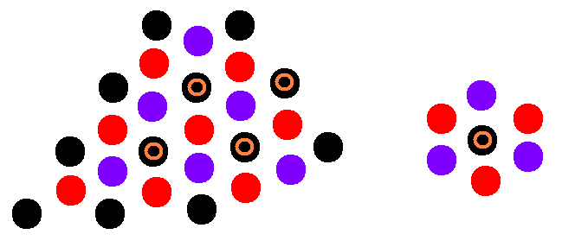
(1) maintain 6-fold symmetry
Primitive hexagonal lattice
c
α
β
b
γ
a
(2) maintain 3-fold symmetry
2/3
2/3
1/3
β
c
α
b
γ
1/3
a
a = b = c;
α = β = γ ≠ 90º

Slide 43
Hexagonal has 1 types
1. Primitive hexagonal
Rhombohedral (trigonal)
2. Primitive rhombohedral (trigonal)

Slide 44
(6) Cubic system
c
a = b = c;
α = β = γ = 90º
β
α
b
a
γ
4 triad axes ( triad axis = cube diagonal )
Cubic is a special form of Rhombohedral lattice
Cubic system has 4 triad axes mutually inclined along cube diagonal

Slide 45
(a) Primitive cubic
α = 90º
c
a = b = c;
α = β = γ = 90º
β
α
b
a
γ
(b) Face centered cubic
α = 60º
a = b = c;
α = β = γ = 60º

Slide 46
(c) body centered cubic
α = 109º
a = b = c;
α = β = γ = 109º

Slide 47
cubic (isometric)
Special case of orthorhombic with a = b = c
Primitive (P)
Body centered (I)
Face centered (F)
Base center (C)
Tetragonal (I)?
3 fold rotation
disappears
Tetragonal (P)
a = b ≠ c
Cubic has 3 types
1. Primitive cubic (simple cubic)
2. Body centered cubic (BCC)
3. Face centered cubic (FCC)

Slide 48
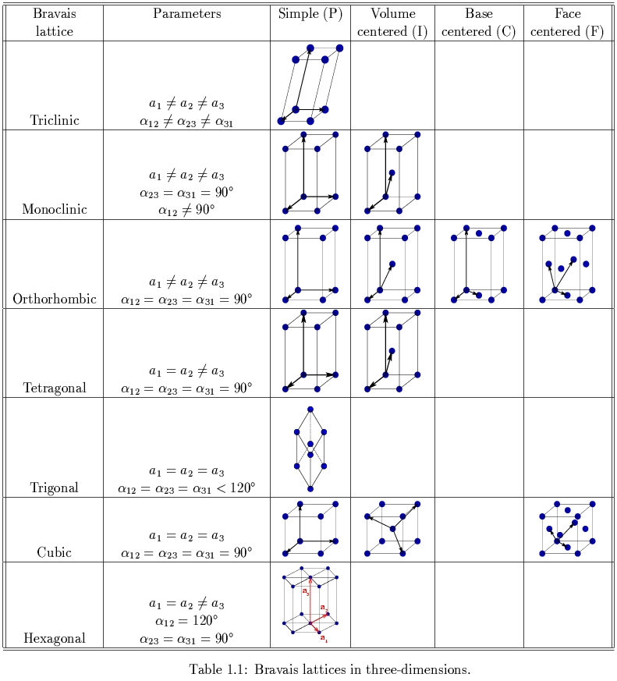
√
http://www.theory.nipne.ro/~dragos/Solid/Bravais_table.jpg
= P
= I
= T P

